Slide 1
Update
2026-06-26

Slide 2
FPGA
Code is working:
Connect to the FPGA
Detects if one Intan module is connected
Read data and store it in PC
Can easily do iteration when time comes
Small issue:
Chip is running hot
Will add a heatsink

Slide 3
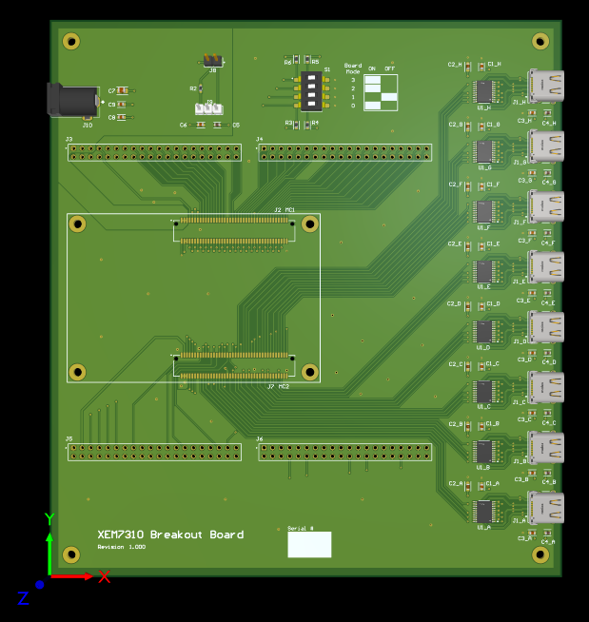
Breakout Board
Board is done
Just need to generate gerber files and order

Slide 4

Electrode patch
Electrode shape
13 microneedle / electrode
5 mm spacing
4 x 8 grid / patch
50 µm diameter
500 µm pitch
400 µm length

Slide 5
Electrode patch
General look of one patch
Half like this, half “mirrored”
Work in progess
Main focus
Contact
With
Intan
Electrode grid

Slide 6
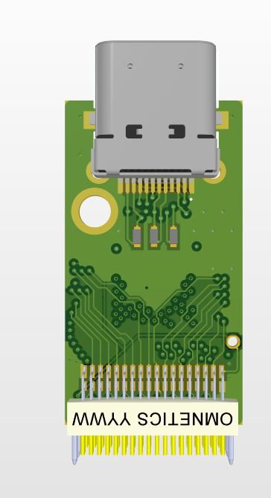
Intan module modification
I have the files from David-Alexandre
Will work on that after electrode sample

Slide 7
To DO list
Order Breakout board
Finish first version of electrode patch for review
If I have the time, work on the Intan module modification

